Slide 1
Future OPIR Ground Architecture Development Methodology
October 13, 2020
Dr. John Lynch
Enterprise Architect

Slide 2
Purpose
Investigate architectural development methodologies (ADM) and provide a recommended ADM to use for the development of Future Ground.
Goals of an ADM
Fits within existing DoD business practices
Covers the lifecycle
Comprehensive
Easy to convey

Slide 3
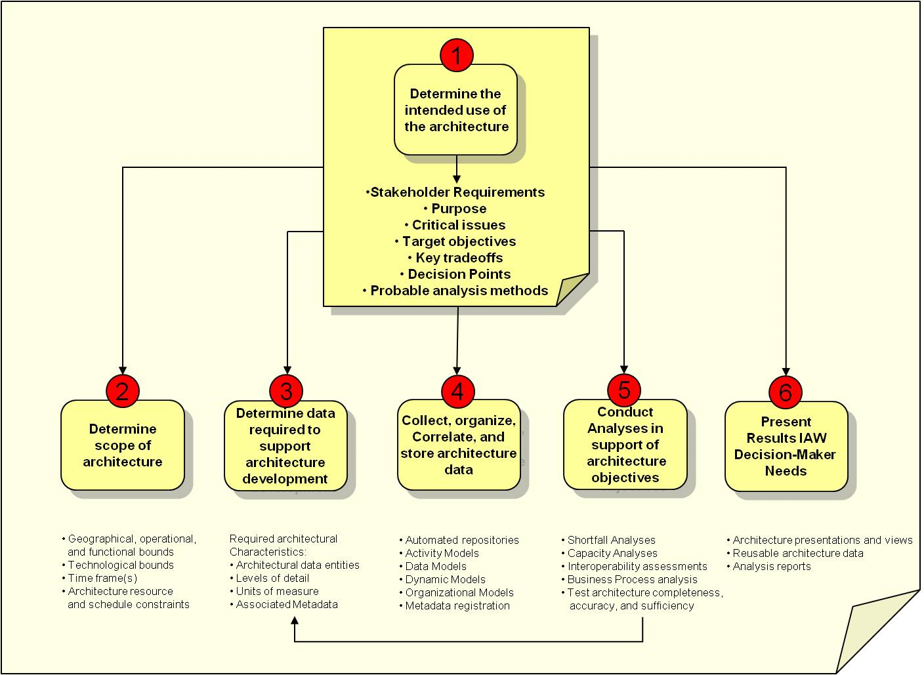
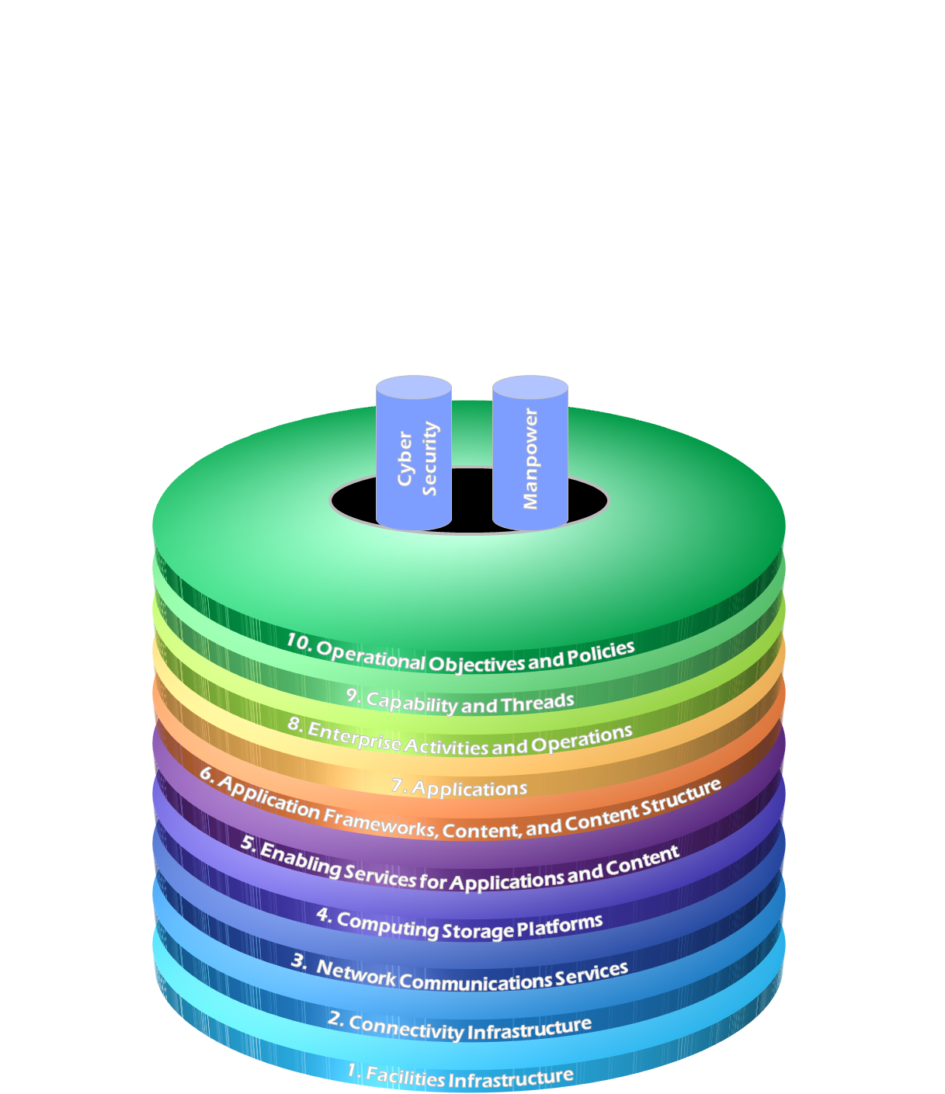
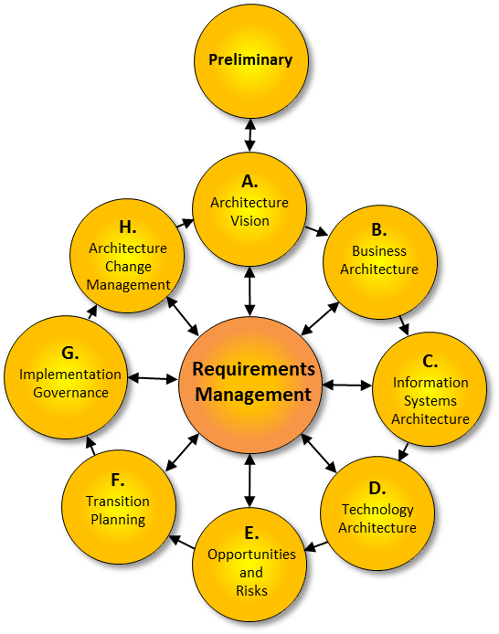
Common ADMs used in Government
The Open Group Architectural
Framework (TOGAF)
Joint Archiecture
Reference Model (JARM)
The Department of Defense
Architectural Framework (DoDAF)

Slide 4
The Open Group Architecture Framework (TOGAF)
Standard ADM used in Federal Government (non-DoD)
Comprehensive ADM
Easy to convey inter-relation between architecture and system lifecycle
Focus on methodology and business processes
Generally not used in DoD

Slide 5
Department of Defense Architecture Framework (DoDAF)
Standard ADM used in DoD
Comprehensive ADM
Focus on architectural views and less on methodology
Generally not used outside DoD
Can be more difficult to convey to senior leadership

Slide 6
Joint Architecture Reference Model (JARM)
Standard ADM used in NRO
Comprehensive ADM
Aligned closely with OSI-layer model
Focus on content and less on methodology
Generally not used outside NRO
Can be more difficult to convey to senior leadership

Slide 7
Recommended ADM Visual DoDAF (vDodAF)
Blend the best of TOGAF, JARM with DoDAF
Utilize the Methodology of TOGAF
Comprehensive
Easy to convey and associate products in the lifecycle
Integrate the Physical Plant of JARM
Facilities
Needed to space, power/cooling capacity planning
Utilize the specific DoDAF views
Well understood
Fits within DoD business practices
Guiding
Principles /
Constraints
Set the
Foundation
Use /
Implement
The
Architecture
A.
Architecture Vision
H.
Architecture
Change
Management
B.
Operational
G.
Implementation
Governance
C.
Systems / Services
Requirements
Management
Generate
The
Architecture
F.
Transition
Planning
D.
Infrastructure
E.
Opportunities
and
Risks
Plan
The
Transition

Slide 8
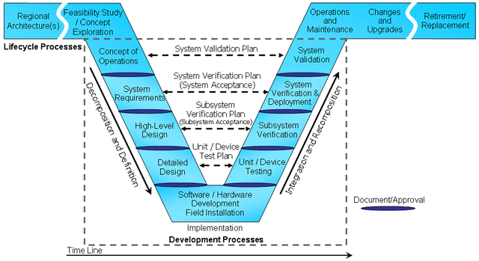
Recommended ADM Visual DoDAF (vDodAF)
Guiding
Principles /
Constraints
A.
Architecture Vision
H.
Architecture
Change
Management
B.
Operational
Government
G.
Implementation
Governance
C.
Systems / Services
Developer
Requirements
Management
F.
Transition
Planning
D.
Infrastructure
E.
Opportunities
and
Risks
Visual DoDAF covers the Systems Engineering lifecycle

Slide 9
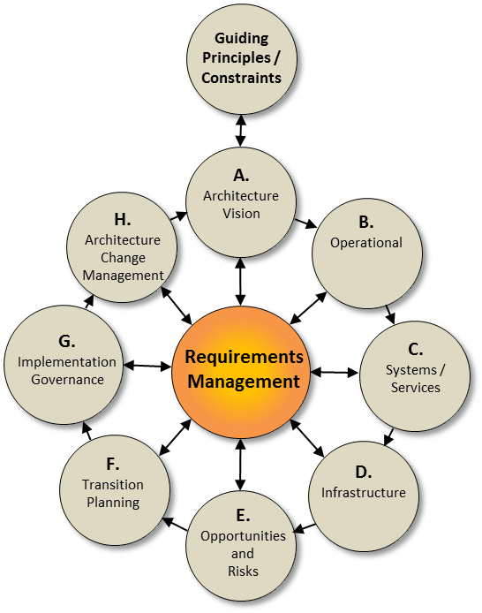
Requirements Management
Centerpiece of ADM, contains requirements and capability linkages that unifies the architecture
Sample Products
Requirements Management Plan
Requirements Database
Requirements Traceability
Specifications
Interface Control Documents
vDoDAF ADM

Slide 10
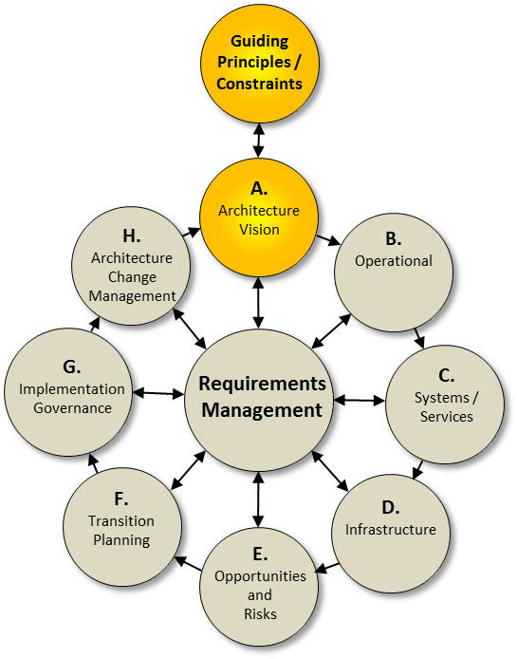
Set the Foundation
Defines the goals and objectives for the architecture
Sample Products
Analysis of Alternatives
Capability Description Document
Concept of Operations
Capability Views
Mission Trades
Operational Context (OV-1)
Operational Requirements Document
vDoDAF ADM

Slide 11
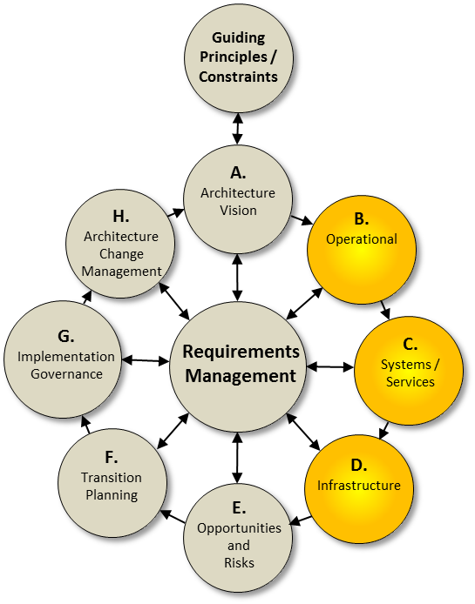
Generate the Architecture
Defines the intended architecture
Sample Products
Define Operational Scenario
OV-5b, OV-2
Define services oriented arch
SvcV-1, SvcV-4
Define solution for ops scenario
SV-1, SV-2, SV-4, SV-5a
Define Infrastructure
Facility capacity (cabling, floor space, etc.)
Heating/Cooling/Power constraints
Compute/Storage/Networking/Comm resources
Operational Concept
Lifecycle Support Plan
System Trades
vDoDAF ADM

Slide 12
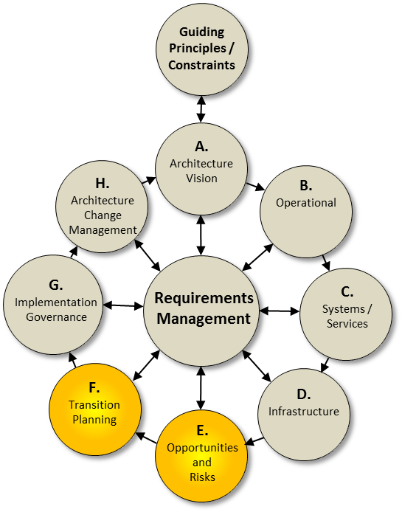
Manage the Transition
Defines and orchestrates the integration, migration, and transition of the architecture
Sample Products
Transition and Sequencing Plan
Integration Plan
Test Plan
Test Procedures
System Verification and Validation
IA accreditation
Operational Testing and Certifications
Risk and Opportunity Management
Training
vDoDAF ADM

Slide 13
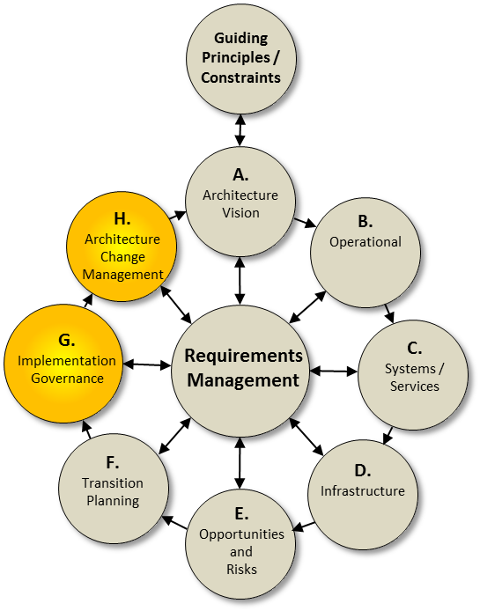
Use / Implement the Architecture
Defines and controls the management of the architecture
Sample Products
Systems Engineering Plans
Enterprise Governance
Configuration Management Plan
Integrated Master Schedule
Work Breakdown Structures
OPS/Transition Readiness
EA assessment
vDoDAF ADM

Slide 14
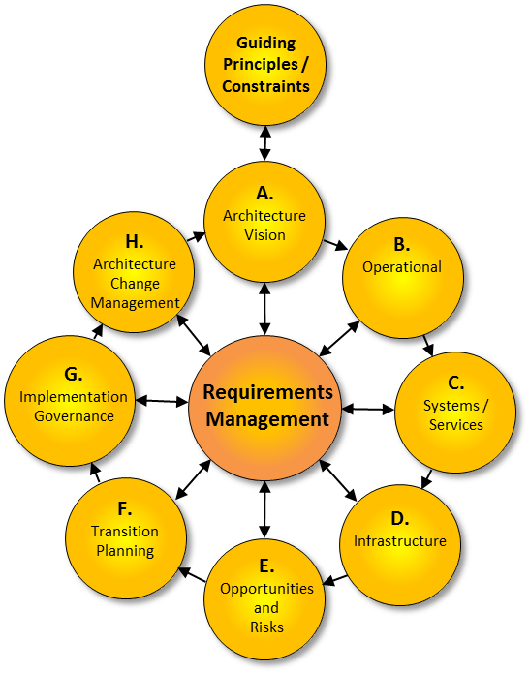
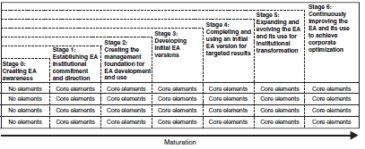
Enterprise Maturity
EAMMF is a GAO process for assessing an organizations use of Enterprise Architecture
EAMMF divides into 7 stages
0-3: Creating an Initial EA
4: Completing & Using the Initial EA
5-6: Expanding, Evolving and Improving the EA
Similar to CMMI

Slide 15
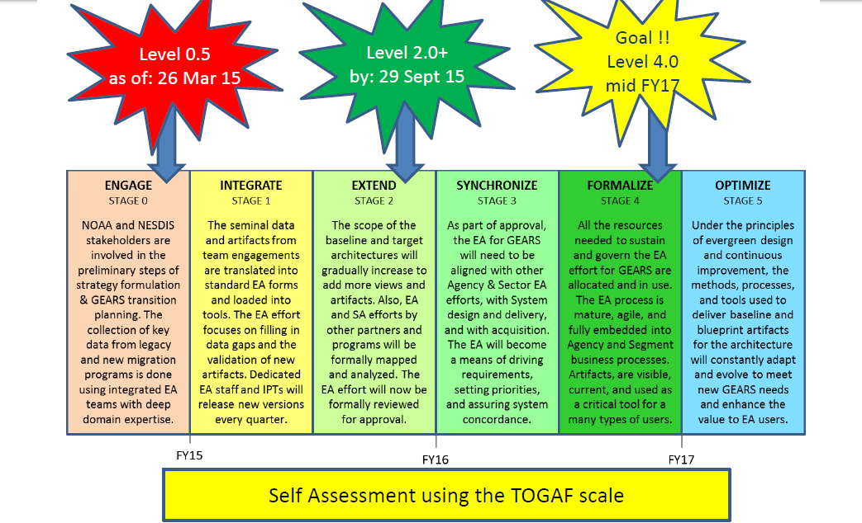
TOGAF Maturity Scale NOAA Example

Slide 16
Architecture Maturity Stage 0
No core elements apply

Slide 17
Architecture Maturity Stage 1
Demonstrates commitment
1 – Written & approved organization policy exists for EA
2 – Executive Committee representing the enterprise exists & is responsible for EA
3 – Executive Committee is taking steps to address EA cultural barriers
Provides capability to meet commitment
4 – Executive Committee members are trained in EA principles & concepts
5 – Chief Architect exists
7 – EA Framework(s) is/are adopted
Demonstrates satisfaction of commitment
6 – EA purpose is clearly stated
Verifies satisfaction of commitment
8 – EA Performance & Accountability framework is established

Slide 18
Architecture Maturity Stage 2
Demonstrates commitment
9 – EA budgetary needs are justified & funded
Provides capability to meet commitment
10 – EA Program Office exists
11 – Key Program Office leadership positions are filled
12 – Program Office human capital plans exist
13 – EA Development & maintenance methodology exists
14 – Automated EA Tool(s) exist
Demonstrates satisfaction of commitment
15 – EA Program Mgmt Plan exists & reflects….
16 – WBS & Schedule to develop EA exists
17 – EA Segments, federation members, and/or extended members have been identified & prioritized
Verifies satisfaction of commitment
18 – Program Office readiness is measured & reported

Slide 19
Architecture Maturity Stage 3
Demonstrates commitment
19 – Organization business owner & CXO representatives are actively engaged in architecture development
Provides capability to meet commitment
20 – EA human capital plans are being implemented
21 – Program Office contractor support needs are being met
22 – Program Office staff are trained in EA Framework, Methodology & Tools
23 – Methodology & tools exist to determine investment compliance with corporate & subordinate architectures
24 – Methodologies & tools exist to determine subordinate architecture alignment with corporate EA
25 – EA-related risks are proactively identified, reported, & mitigated

Slide 20
Architecture Maturity Stage 3 cont’d
Demonstrates satisfaction of commitment
26 – Initial versions of corporate “As-Is” & “To-Be” EA & Sequencing plan are being developed
27 – Initial versions of corporate EA describing the enterprise in terms of performance, business, data, services, technology, & security is being developed
28 – One of more segment and/or federation member architectures is being developed
29 – Products are being developed according to the EA content framework
30 – Products are being developed according to a defined EA methodology
31 – Products are being developed using EA tools
Verifies satisfaction of commitment
32 – Architecture development progress is measured & reported

Slide 21
Architecture Maturity Stage 4
Demonstrates commitment
33 – Executive committee has approved the initial version of the corporate EA
34 – Key stakeholders have approved the current version of subordinate architectures
Provides capability to meet commitment
36 – Program office human capital needs are met
Demonstrates satisfaction of commitment
37 – Initial versions of corporate “as-is” and “to-be” EA and sequencing plan exists
38 – Initial version of corporate EA captures performance, business, data, services, technology, and security views
39 – One or more segment and/or federation member architectures exists and is being implemented
Verifies satisfaction of commitment
40 – EA product quality is measured and reported
41 – EA results and outcomes are measured and reported
42 – Investment compliance with corporate and subordinate architectures is measured and reported
43 – Subordinate architecture alignment with the corporate EA is measures and reported

Slide 22
Architecture Maturity Stage 5
Demonstrates commitment
44 – Organization head has approved current version of corporate EA
45 – Organization component heads or segment owners have approved current version of their respective subordinate architectures
Provides capability to meet commitment
46 – Integrated repository tools and common EA framework and methodology are used across the enterprise
47 – Corporate and subordinate architecture program offices operate as a single virtual office that shares resources enterprise-wide.
Demonstrates satisfaction of commitment
48 – Corporate EA and sequencing plan are enterprise-wide in scope
49 – Corporate EA and sequencing plan are aligned with subordinate architectures
50 – All segment and/or federated architectures exist and are horizontally and vertically integrated
51 – Corporate and subordinate architectures are extended to align with external partner architectures
Verifies satisfaction of commitment
52 – EA products and management processes are subject to independent assessment

Slide 23
Architecture Maturity Stage 6
Demonstrates commitment
53 – EA is uses by executive leadership to inform organization strategic planning and policy formulation
Provides capability to meet commitment
54 – EA human capital capabilities are continually improved
55 – EA methodologies and tools are continually improved
56 – EA management processes are continually improved and reflect the results of external assessments
Demonstrates satisfaction of commitment
57 – EA products are continually improved and updated
Verifies satisfaction of commitment
58 – EA quality and results measurement methods are continually improved
59 – EA continuous improvement efforts reflect the results of external assessment

Slide 24
Questions?

