Slide 1
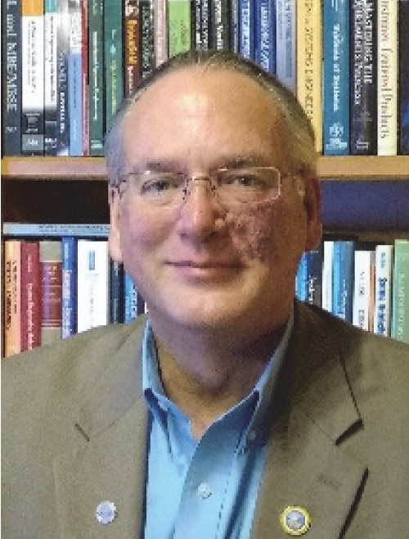
System Engineering Principles
November 6th-10th
Earn up to 30 INCOSE PDUs!
Instructor – David D. Walden, ESEP SYSNOVATION
This is an in-depth course for Systems Engineering Practitioners and will provide an overview of the fundamental principles, focusing on holistic perspectives, balanced trade-offs, and life cycle considerations.
Follows the basic outline and conventions of the INCOSE Systems Engineering Handbook, ISO/IEC/IEEE 15288, and the Guide to the Systems Engineering Body of Knowledge (SEBoK).
Use this QR Code to see a summary of the course content.
When: Monday-Friday, November 6th-10th, 2023
08:30-16:00, with breaks
Where: RFA Engineering
12986 Valley View Road
Eden Prairie, MN
55344
Cost: $2250/student
$1950/student (SAE and INCOSE Members)
The price includes a hard copy of the training material,
the latest INCOSE SE Handbook, refreshments, and lunches.
Open enrollment is limited to 10 students, so register soon to hold your spot for this class!
Registration
Link
Event
Contact
Jon Ness, info@matrixengrg.com
(612) 419-8184

