Slide 1
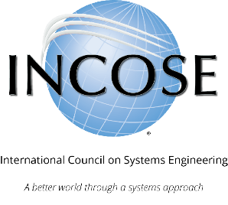
INCOSE Systems Engineering Professional (SEP) Certification Program
Program Summary

Slide 2
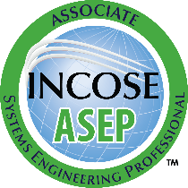
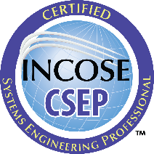
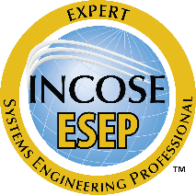
INCOSE SEP Architecture For wherever you are in your career
Multi-Level Base Credentials
The base ASEP, CSEP, and ESEP credentials cover the breadth of systems engineering at increasing levels of leadership, accomplishments, and experience.
If you have just started (or plan to start) practicing systems engineering or have recently graduated and are interested in system engineering
If you are a practicing Systems Engineer with more than five years of systems engineering professional work experience
If you are a systems engineering leader with recognized systems accomplishments and have many years of systems engineering professional work experience

Slide 3
INCOSE SEP Program Purpose and Benefits
The INCOSE SEP program offers independent assessment of system engineering professionals benefiting:
SYSTEMS ENGINEERING COMMUNITY:
Creates the standard to identify and develop systems engineering professionals.
Establishes a formal, recognized body of knowledge for the systems engineering community.
SYSTEM ENGINEERING PROFESSIONALS:
Provides a portable standard of recognition for attainment of knowledge, education, and experience.
Serves as a mechanism for continued professional development through recertification requirements.
ORGANIZATIONS/INSTITUTIONS:
Offers a universal, industry-approved measure of a professional’s knowledge –achieved through the independent evaluation of relevant tasks, projects, and programs.

Slide 4
What is INCOSE?
The International Council on Systems Engineering (INCOSE) is a not-for-profit membership organization founded in 1990 to develop and disseminate the interdisciplinary principles and practices that enable the realization of successful systems. A better world through a systems approach.
MISSION Share, promote and advance the best of systems engineering from across the globe for the benefit of humanity and the planet.
VISION The world's authority on Systems Engineering.
Certification is just one of many INCOSE products and offerings.
incose.org/certification | 4

Slide 5
Employer Job Postings ask for SEP
Employers who recognize and value SEP certifications

Slide 6
Universities have Certification Agreements
INCOSE and the following Universities have signed agreements to recognize college courses
ACADEMIC EQUIVALENCY
Notes:
How to apply for aceq: https://www.incose.org/_pdp/pdp_details?item=615

Slide 7
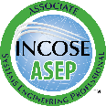
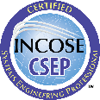
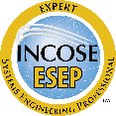
Other Certification Agreements
INCOSE and the following organizations have signed agreements for existing certifications to meet some of the SEP requirements or offering a discount on application fees
incose.org/certification | 7

Slide 8
What Certification is Right for You?
If you have just started (or plan to start) practicing systems engineering or have recently graduated and are interested in systems engineering
No matter where you are in your professional career, we offer SEP’s for every level.
Plan the next step in your career!
If you are a practicing Systems Engineer with more than five years of systems engineering professional work experience
If you are a systems engineering leader with recognized systems accomplishments and have many years of systems engineering professional work experience

Slide 9
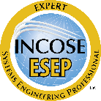
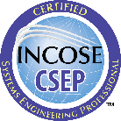
Different Requirements for Each Level
ESEP focused on:
- Leadership
- SE Accomplishments
- Significant SE Experience
You can enter at whatever SEP level is appropriate and transition between levels when ready.
CSEP focused on:
- SE Experience
- Applied SE Knowledge
ASEP focused on:
- SE Knowledge
SEP Candidates

Slide 10
Associate Systems Engineering Professional
If you have just started practicing – or want to start practicing – systems engineering, then ASEP is for you. This certification is for people at the beginning of their career as a systems engineer. The ASEP has “book knowledge” but not yet significant experience as a systems engineer.
Knowledge verification required
Suitable for students, early career professional, project and program managers, and all those who “speak systems engineering”” but do not have verifiable experience.

Slide 11
Certified Systems Engineering Professional
If you are a practicing Systems Engineer with more than five years of systems engineering professional work experience, then CSEP is for you.
Knowledge verification required
At least five years of experience required
At least five years of experience verification required
Suitable for independent practitioners, which includes most systems engineers.

Slide 12
Expert Systems Engineering Professional
If you are a systems engineering leader with recognized systems accomplishments and have many years of systems engineering professional work experience, then ESEP is for you.
At least 20 years of experience required
At least 10 years of experience verification required
Suitable for technical leaders who have “moved the needle” in applying systems engineering within a community, which may include their employer, client, or a professional society. Few individuals meet the ESEP requirements, even if they have been practicing systems engineering for a long time.

Slide 13
Knowledge Verified by Exam or Coursework
Knowledge Requirements
Based on INCOSE Systems Engineering Handbook v4
Required for ASEP and CSEP certification
Can be verified through knowledge exam
Can be verified through university coursework
Exam is
100 multiple-choice questions
100 minutes for exam
Proctored by video through computer or in-person at INCOSE events
Administered online with video proctoring
Offered as a pencil-and-paper test at many INCOSE events
Allowed to be attempted up to 3 times per 12 months
Academic Equivalency allows course assessments to meet knowledge requirement
Must score highly in pre-approved university course
Course may be taught in any language and may use a wide variety of assessment methods
Course must use INCOSE SE Handbook
Notes:
Exam transition to SEH5E: https://www.incose.org/_pdp/pdp_details?item=682

Slide 14
Experience Documented By Area
CANDIDATE MUST PROVIDE A MAP OF THEIR EXPERIENCE
CSEP: 1 Year Experience in 3 of the Areas
ESEP: 2 Years Experience in 6 Areas
Requirements Engineering
System and Decision Analysis
Architecture / Design Development
System Integration
Verification and Validation
System Operation and Maintenance
Technical Planning
Technical Monitoring and Control
Acquisition and Supply
Information Management and Configuration Control
Risk and Opportunity Management
Lifecycle Process Definition and Management
Specialty Engineering
Organizational Project Enabling Activities
Other
incose.org/certification | 14

Slide 15
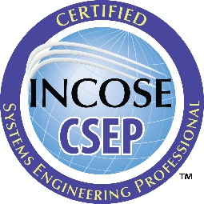
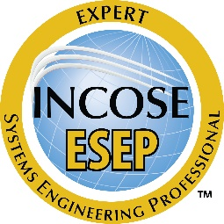
Certification & Reference Experience Requirements
SYSTEMS ENGINEERING EXPERIENCE
CSEP has > = 5 years of professional-level SE experience
ESEP has > = 20 years of professional-level SE experience
EXPERIENCE CONFIRMATION
Recommendations from at least 3 colleagues / peers / managers
References must confirm SE experience claims
References must be knowledgeable of systems engineering but need not be SE’s
MUST USE INCOSE FORMS
incose.org/certification | 15

Slide 16
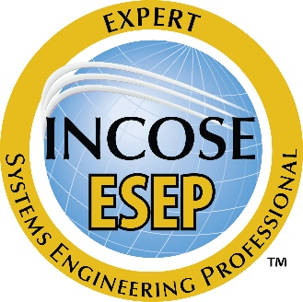
ESEP Technical Leadership Requirements
Minimum of 5 years of professional development
Product Development Leadership, Technical Society Leadership, and Advanced Academics
ESEP candidates participate in audio interview to confirm SE leadership
incose.org/certification | 16

Slide 17
ASEP and CSEP Renewal
CERTIFICATION IS VALID FOR DEFINED TIME PERIOD
5 Years for ASEP
3 Years for CSEP
Indefinite for ESEP
All levels must maintain INCOSE individual membership
CERTIFICATION RENEWAL REQUIRES CONTINUING EDUCATION
Minimum of 120 Professional Development Units (PDUs)
Technical Society participation
SE course work and publications
SE job functions beyond daily work

Slide 18
What People Are Saying
Diego Rangel
David R. Schneider
Raksha Mani
Kahdeem Cohens
“I understood that it is essential to certify your knowledge, especially at the beginning of your career. The SEP certification is an excellent way to demonstrate your qualification standard since it is internationally recognized. This motivated me to get SEP Certification.”
“For the university, Academic Equivalency helps to ensure that the curriculum is well-aligned to the INCOSE methodologies and hence has significant professional value for our students. It also distinguishes the course(s)/program offering academic equivalency from peer institutions.
For students, they too earn additional distinction as it is not just the institution stating their SE skill capability, but the student has demonstrated that they met the larger standard established by INCOSE.”
“The SEP certification by the INCOSE is a universally recognized certification, helping me prove my competence and knowledge in the different aspects of systems engineering.”
“I promote SEP certification. I would suggest that everyone considering it do some introspection on their "why."
In an ideal world, all systems engineering professionals are INCOSE SEPs for personal motivations like recognition, objective communication of your knowledge, and the ability to apply systems engineering learnings in the workplace.”
Notes:
www.incose.org/certblog

Slide 19
Bring INCOSE to your community
Email info@incose.net to request an INCOSE Central representative to come to your next
meeting, conference, or event.
Personal INCOSE presence
Custom presentation for your needs and interests
Best practices for getting your employees or members certified
Notes:
An INCOSE rep can speak about a range of topics including certification, membership, working groups, initiatives, marketing, events, etc.

Slide 20
Additional INCOSE Resources
INCOSE Youtube Channel
INCOSE Publications
Calling All Systems
INCOSE Guides, Processes, Models, and Other Technical Products
Members Only: iNET MarCom Member Resources

Slide 21
Any Questions?
Certification Office certification@incose.net
For more information visit www.incose.org/certification

Slide 22
INCOSE Copyright Notice
Copyright © 2006-2024 by INCOSE, subject to the following restrictions:
Author Use. Authors have full rights to use their contributions in a totally unfettered way. Abstraction is permitted with credit to the source.
INCOSE Use. Permission to reproduce and use this document or parts thereof by members of INCOSE and to prepare derivative works from this document for INCOSE use is granted, with attribution to INCOSE and the original author(s) where practical, provided this copyright notice is included with all reproductions and derivative works.
External Use. This document may be shared or distributed to non-INCOSE third parties. Requests for permission to reproduce this document in whole are granted, provided it is not altered in any way. Requests for permission to prepare derivative works of this document for external and/or commercial use will be denied unless covered by other formal agreements with INCOSE. Copying, scanning, retyping, or any other form of reproduction of the content of whole pages or source documents is prohibited except as approved by the INCOSE Central Office, 7670 Opportunity Rd #220, San Diego, CA 92111.
Electronic Version Use. Any electronic version of this document is to be used for personal use only and is not to be placed on a non-INCOSE sponsored server for general use. Any additional use of these materials must have written approval from INCOSE Central.
Permissions. INCOSE has granted permission to member companies of the INCOSE Corporate Advisory Board to post and use this document internally, subject to the external use restriction.
Technical Data. This data was prepared by INCOSE for information only. It has been released by INCOSE as Technical Data. It is subject to change without notice and may not be referred to as an INCOSE Technical Product.
This briefing was created from information from various INCOSE sources as indicated in the Notes section of this slide. Send comments to certification@incose.org.

Slide 23
Learn more at INCOSE.org/certification
©2023 INCOSE. All rights reserved.

